Slide 1


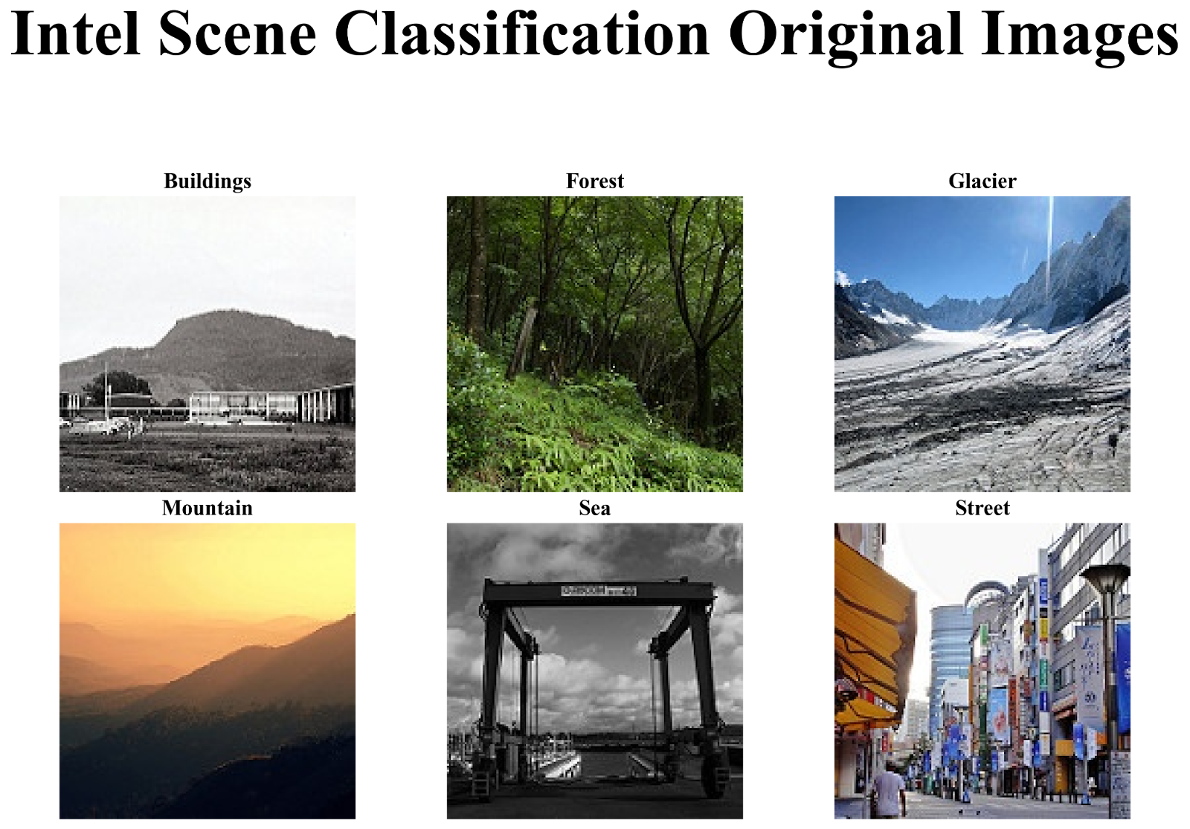
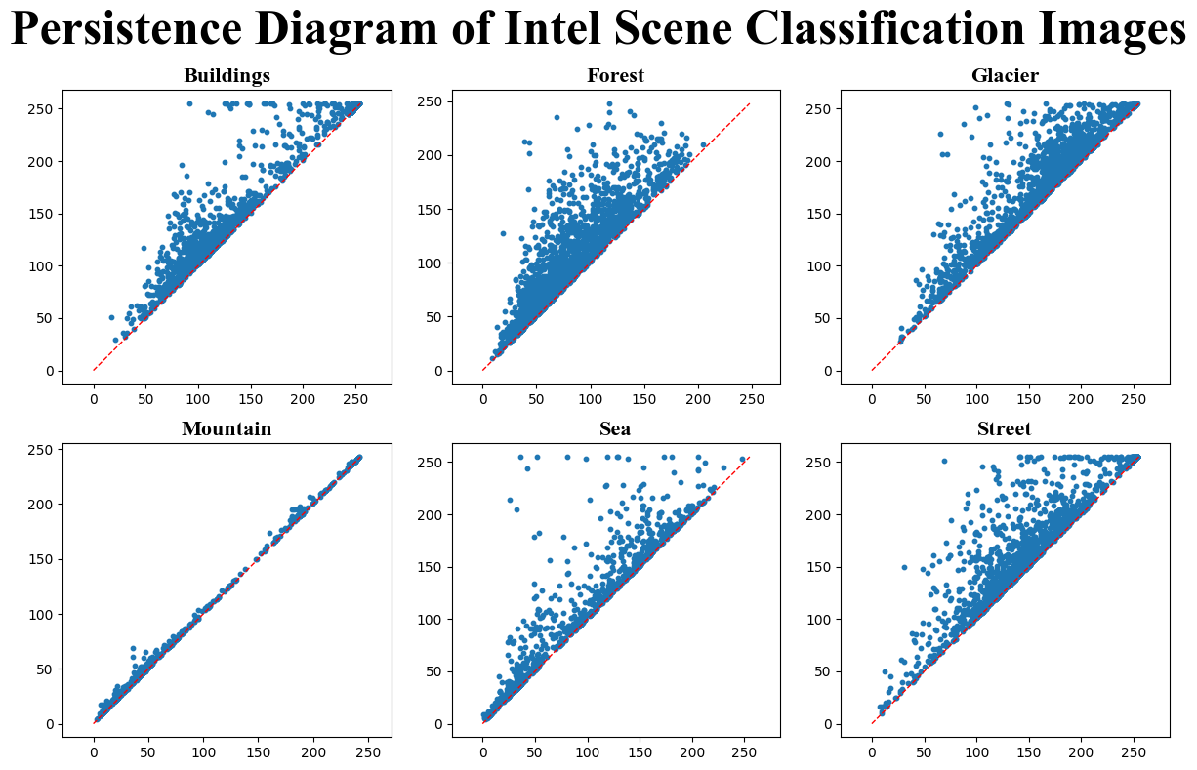
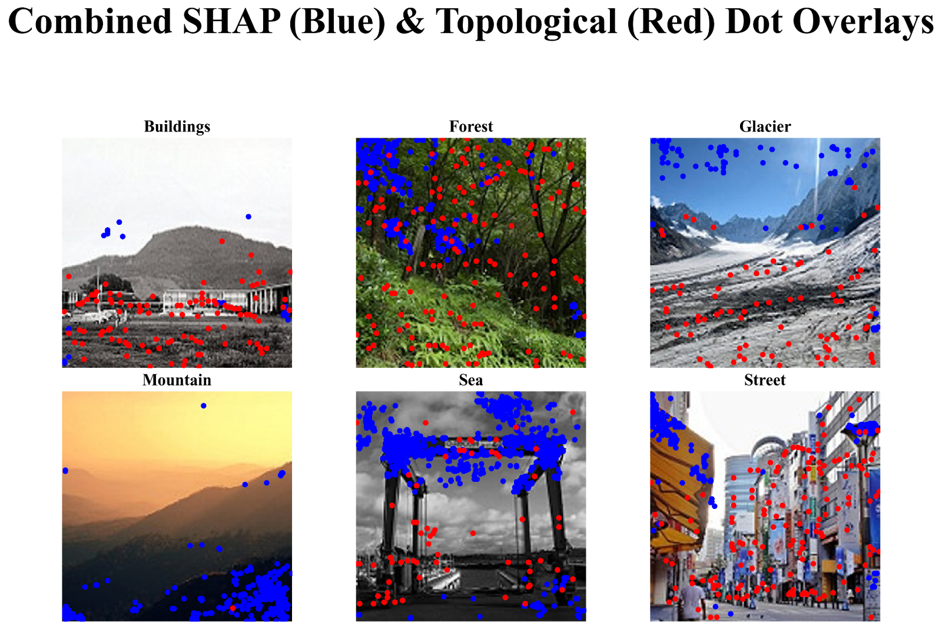
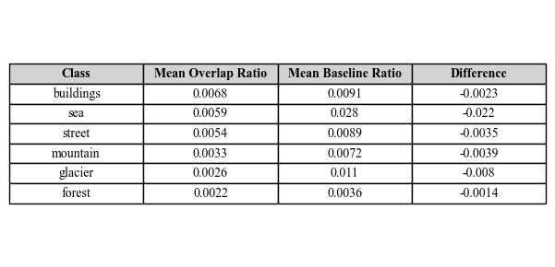
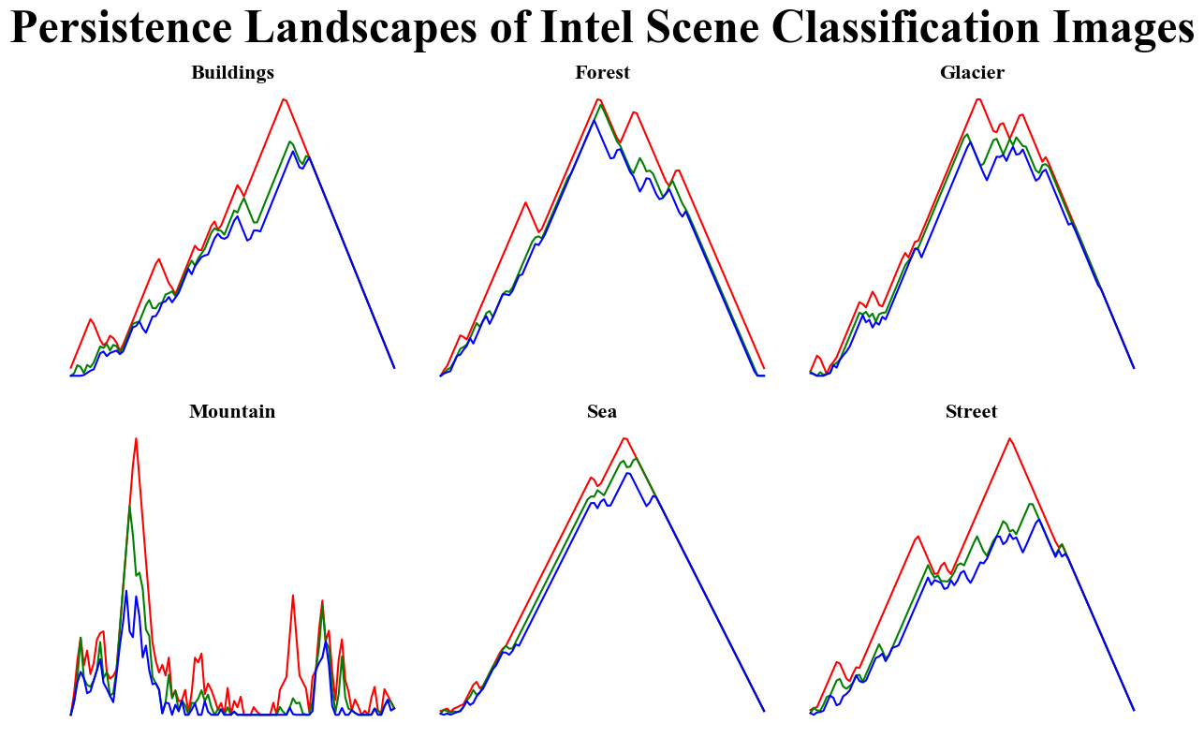
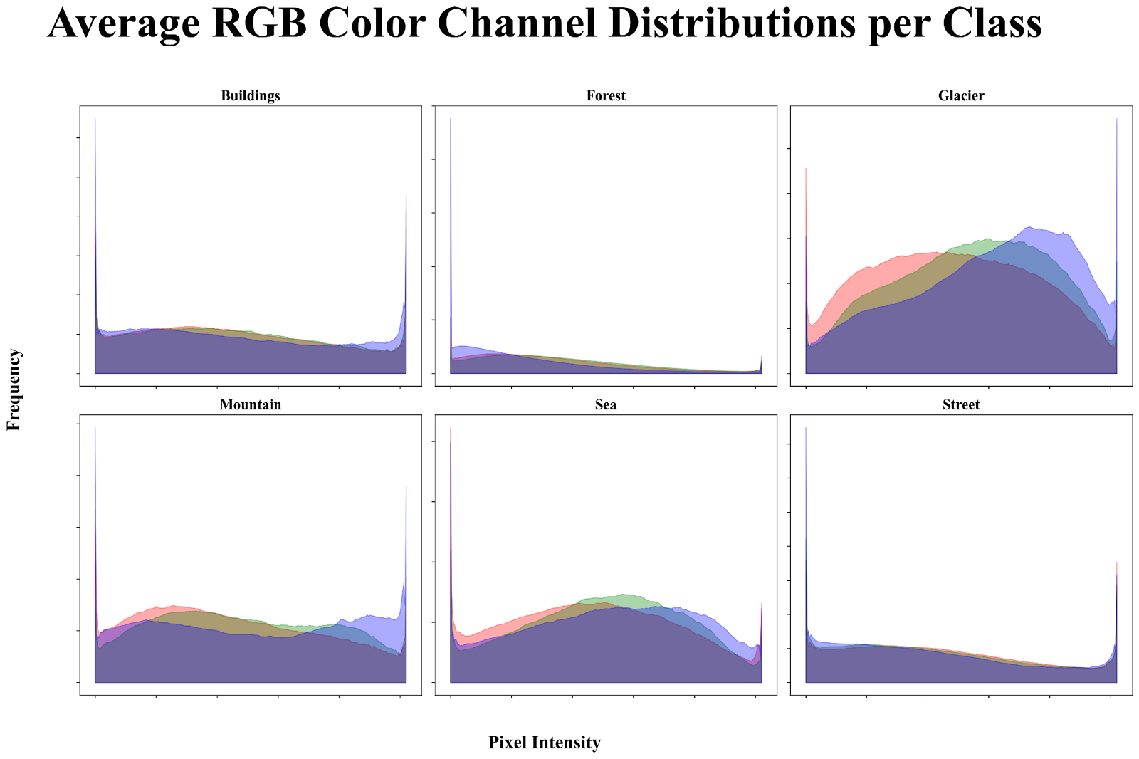
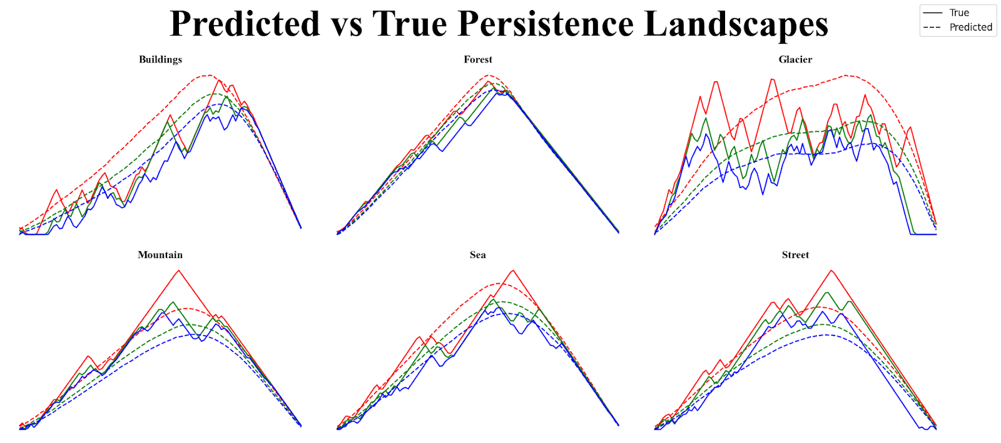
SHAP-Explainable Image-to-Topology Regression
Charles Fanning
Supervisor: Dr. Bin Luo
GRP-021
INTRODUCTION
METHODS
RESULTS & DISCUSSION
Figure 1. Samples from the Intel Scene Classification dataset, each from one of the six scene categories: Buildings, Forest, Glacier, Mountain, Sea, and Street.
Figure 3. Persistence diagrams for one representative image from each class in the Intel Scene Classification dataset. Each point represents the birth and death times of a topological feature, plotted on the horizontal and vertical axes, respectively.
Figure 6. Combined overlay of SHAP (blue) and topological (red) dot positions for each scene category. Pixels with SHAP values above a threshold are marked in blue. Pixels with 1-dimensional topological features with persistence values above a certain threshold are marked in red.
Intel Scene Classification Dataset
~25,000 color images of natural and urban scenes
Six categories: Buildings, Forest, Glacier, Mountain, Sea, Street
Most images are 150 × 150 pixels (minor outliers excluded)
Originally released for an Analytics Vidhya challenge by Intel
Commonly used for scene classification benchmarks
Pre-split into: • ~14,000 training • ~7,000 validation • ~3,000 test
Figure 7. Mean overlap ratio between SHAP explained heatmaps and 1-dimensional topological features across each class. A baseline is given between thresholded SHAP-identified pixels against the heatmap baseline.
Discussion
Across all six classes, the overlap between SHAP attribution heatmaps and 1-dimensional topological features was consistently lower than the baseline (Figure 7). The worst performing observation was in the sea category, where the SHAP-topology overlap was 2.2 percent lower than baseline. The smallest difference was in the forest class, with a difference of 0.14%.
Overall, SHAP explanations consistently aligned with 1-dimensional topological features less than random sampling would suggest.
The predicted persistence landscapes from the DenseNet‑121 model are significantly different from those produced by persistent homology. The persistence landscapes generated through persistent homology are rigid and exhibit many local minima and maxima. The predicted ones tend to be smoother and either unimodal or bimodal.
There are also significant differences in threshold behaviors between the two approaches. The number of persistent features — features that contribute significantly to persistent homology — vary independently of each other. That is, the number of persistent features detected via SHAP is not determined or even dependent on the number of persistent features determined by persistent homology.
Figure 4. Persistence landscapes for representative images from each class in the Intel Scene Classification dataset. Each plot shows the first three landscape functions.
Figure 2. Average pixel-intensity histograms for the Red, Green, and Blue channels across the entire dataset.
Motivation
Sources
Previous work has used deep learning models to predict persistent homology–based representations of data. However, we still are not sure whether these models actually learn topological structure or are just overfit to the output vectorization. We evaluate this by analyzing which input regions most influence the predicted persistence landscape using SHAP.
We train a DenseNet‑121 model to predict 300-dimensional persistence landscape vectors derived from cubical filtrations on grayscale versions of scene images. We then compare the SHAP attribution maps to the hole locations extracted from persistent homology alone.
[1] Analytics Vidhya. (n.d.). Practice problem: Intel Scene Classification Challenge. Retrieved from https://www.analyticsvidhya.com/datahack/contest/practice-problem-intel-scene-classification-challe/
[2] Zomorodian, A., & Carlsson, G. E. (2004). Computing persistent homology. Discrete & Computational Geometry, 33(2), 249–274. https://doi.org/10.1007/s00454-004-1146-2
[3] Bubenik, P. (2012). Statistical topological data analysis using persistence landscapes. Journal of Machine Learning Research, 16, 77-102. Retrieved from http://www.jmlr.org/papers/volume16/12-167/12-167.pdf
[4] Lundberg, S. M., & Lee, S. I. (2017). A unified approach to interpreting model predictions. Advances in Neural Information Processing Systems, 30. Retrieved from https://arxiv.org/abs/1705.07874
Figure 5. Predicted vs. true persistence landscapes for representative images from each class in the Intel Scene Classification dataset. Each plot shows the first three landscape functions (red, green, and blue, respectively), with the model’s predicted curves (dotted) compared to the ground truth (solid).

